Slide 1
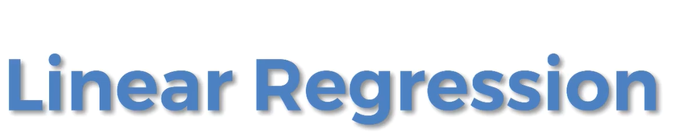

Slide 2
Introduction
Linear regression is a powerful and widely used method to estimate values, such as
  price of a house
  value of a certain stock
  life expectancy of an individual
  amount of time a user will watch a video or spend on a website

Slide 3
Introduction
Regression models describe the relationship between variables by fitting a line to the observed data.
Linear regression models use a straight line, while nonlinear regression models use a curved line.
Regression allows you to estimate how a dependent variable changes as the independent variable(s) change.

Slide 4
Simple Linear Regression
Simple linear regression is used to estimate the relationship between two quantitative variables.
You can use simple linear regression when you want to know:
  The relationship is between two variables
  e.g. the relationship between salary and experience.
  The value of the dependent variable at a certain value of the independent variable
  e.g. the salary at a certain level of experience.
Experience (years) (IDV) | Salary (DV)
1.1 | 39,343
1.3 | 46,205
1.5 | 37,731
2 | 43,525
2.2 | 39,891
2.9 | 56,642
3 | 60,150

Slide 5
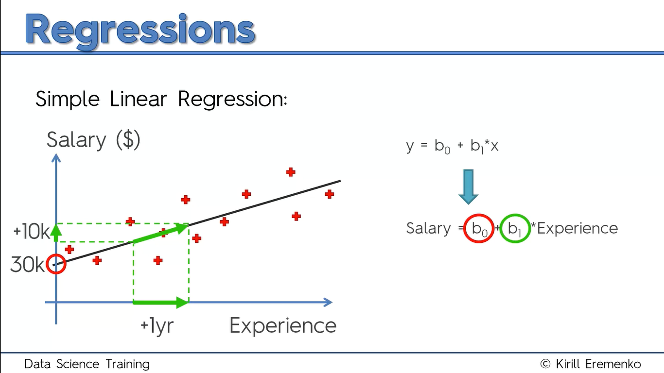

Slide 6
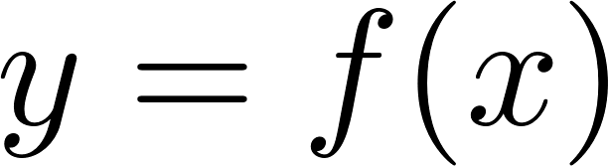
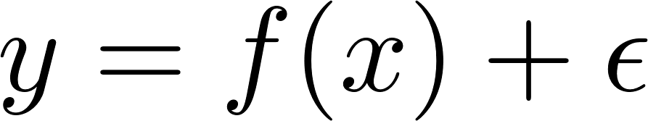
Population versus Sample
Population Regression Function
  Deterministic Component
  Stochastic Component

Slide 7
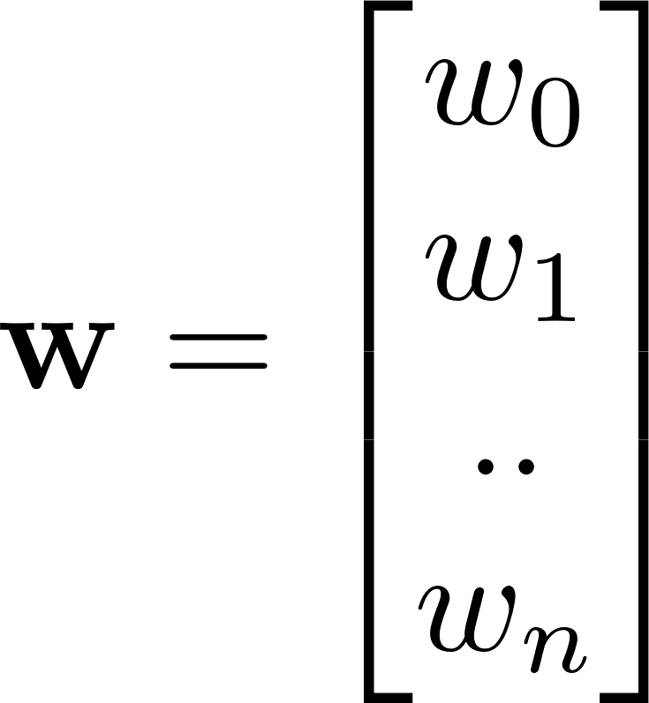
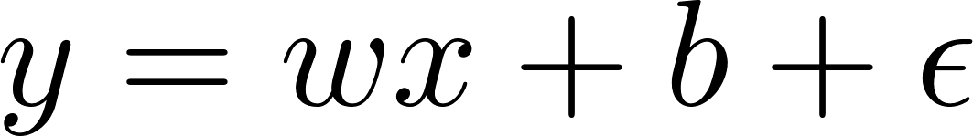
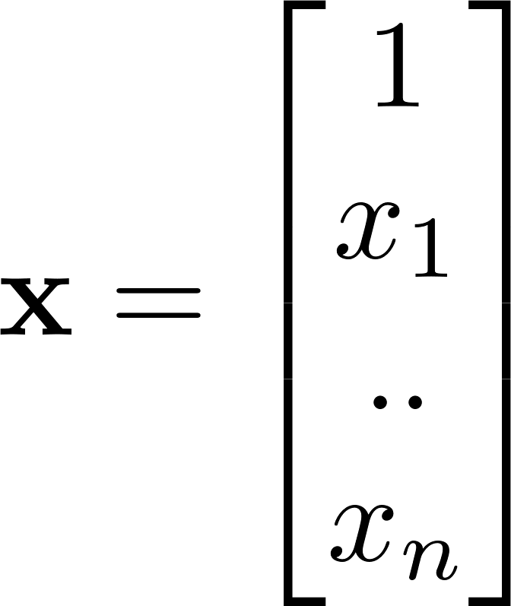
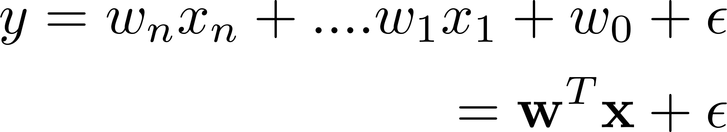
Population versus Sample
Normally distributed error component
Univariate function
Multivariate function

Slide 8
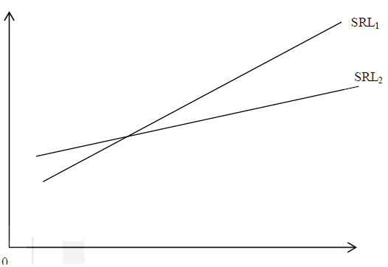
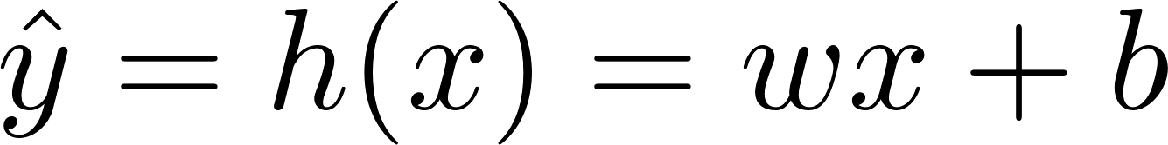
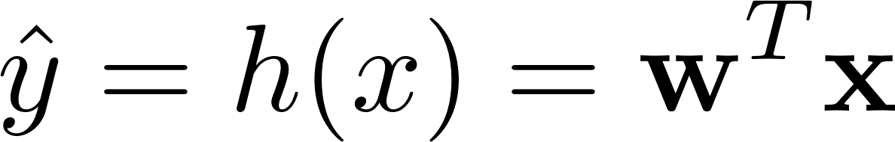
Population versus Sample
Sample Regression Functions
  Different Regression Line/Plane/Hyperplane
Hypothesis function(s)
Univariate function
Multivariate function

Slide 9
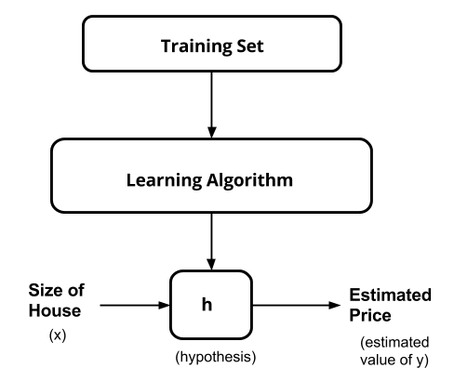
Hypothesis function(s)

Slide 10
Linear Regression algorithm

Slide 11
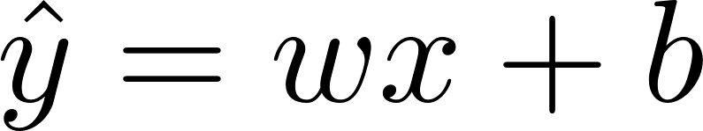
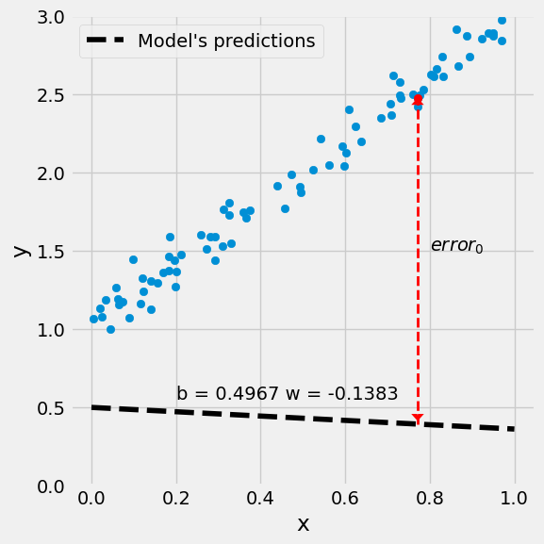
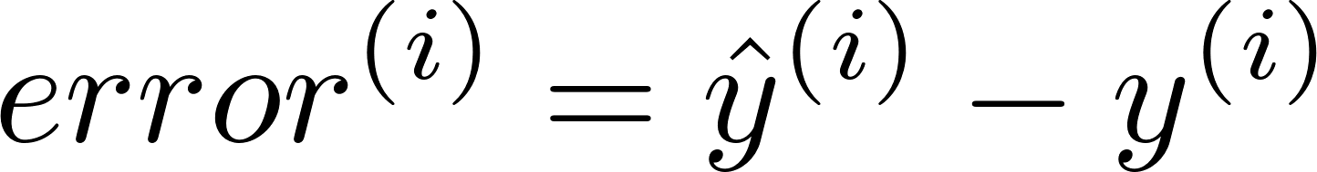
Step 1. Initialization
Assume parametric form
Parametric form of the hypothesis function
Calculate error using the initial w & b

Slide 12
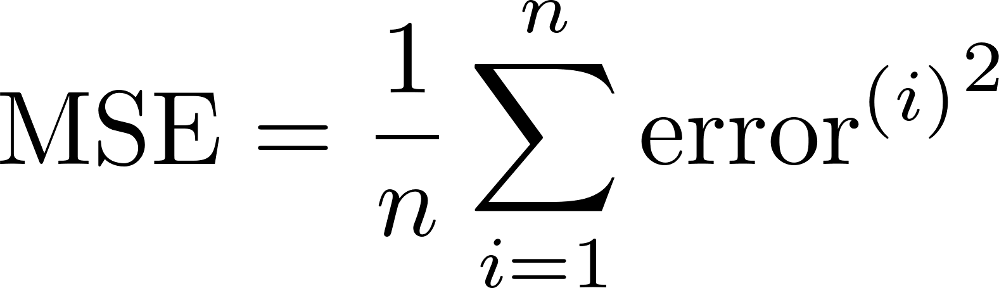
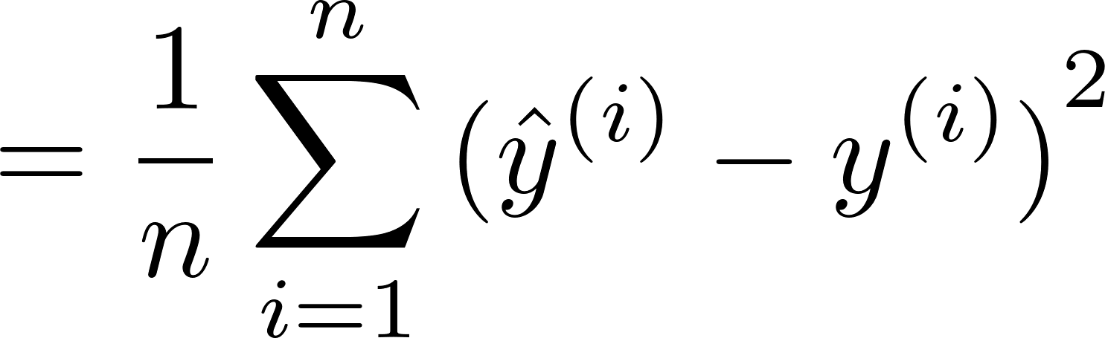
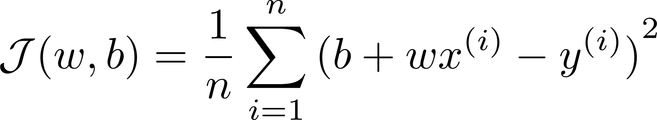
Formulate Objective function
Also called cost / loss function

Slide 13
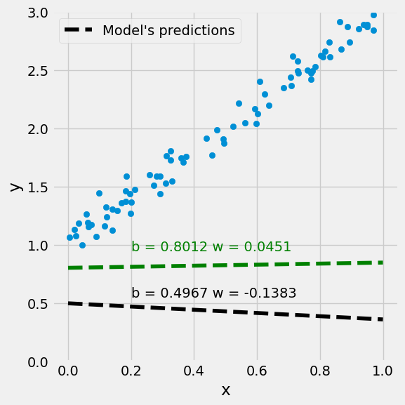
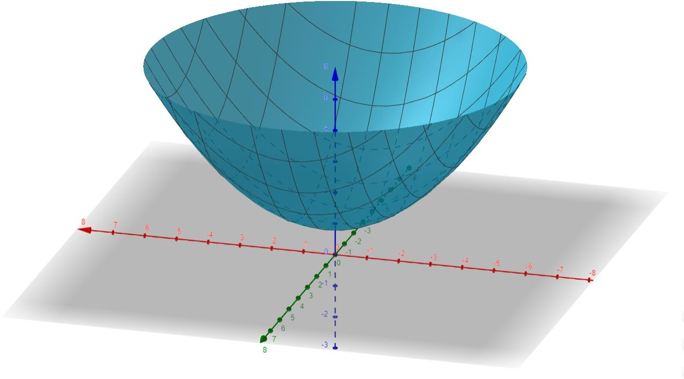


Feature space versus parameter space
w
Find the w & b when the cost is minimum
b

Slide 14
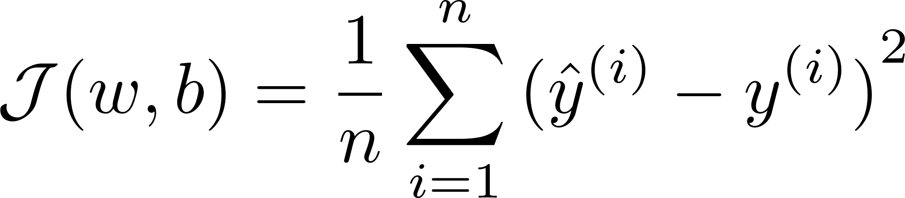
Step 2. Evaluate y-hat & evaluate objective function
Evaluate y-hat
Evaluate objective function (also known as forward pass)

Slide 15
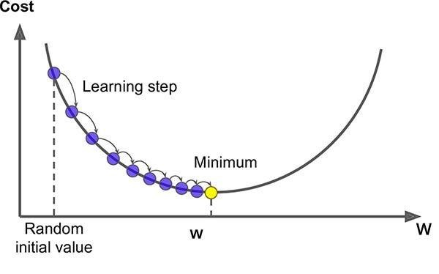


Objective function plot
w
b
Take a little step towards lowest cost.
How little?
Which direction?
16

Slide 16
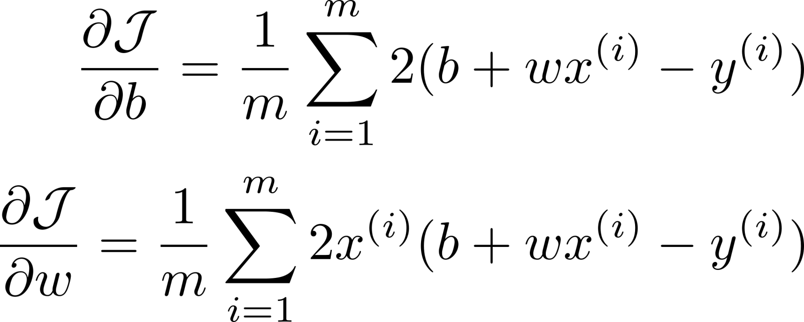
Step 3. Calculate analytical gradients
Calculate gradient

Slide 17
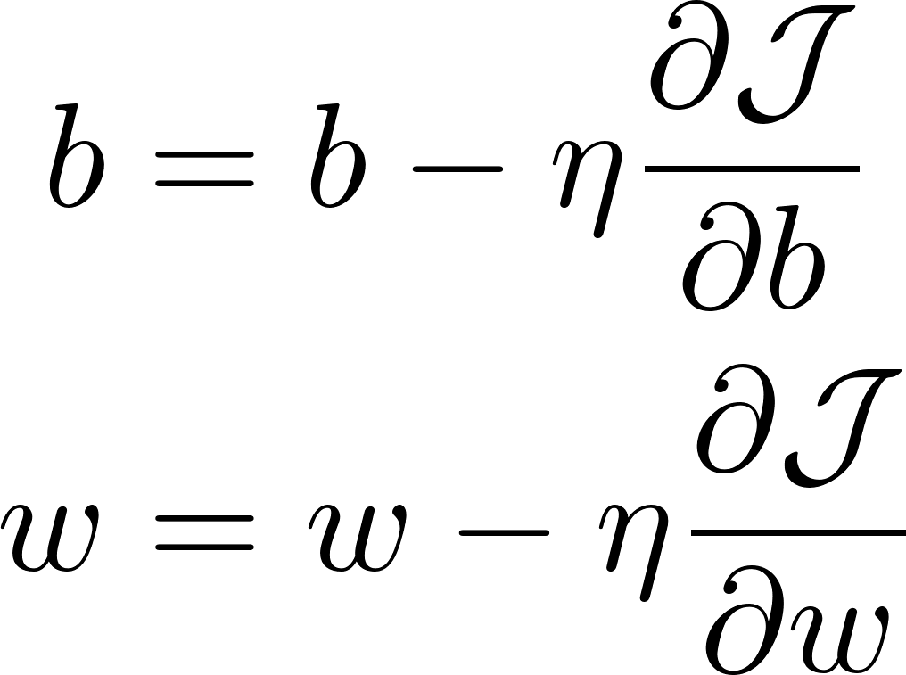
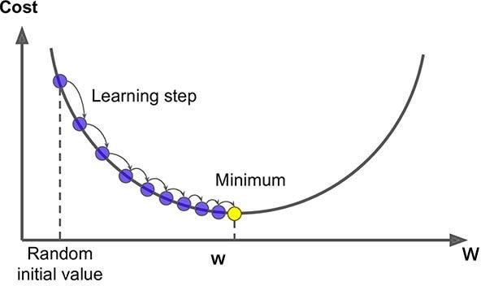
Step 4. Perform numerical gradient descent
Backward pass – update b and w
Repeat Step 2, 3, 4

Slide 18
Change in w and b with gradient descent

Slide 19

Review Linear Regression
Initialization: Select Random w & b, learning rate
Loop
  Calculate new-cost for given w & b
  If (iteration == max) or ((new-cost – old cost) < threshold) break
  Calculate gradients wrt w and b
20

Slide 20
Review Linear Regression
  Do gradient descent to update/ calculate cost function
• stop: if old cost = new cost
20

Slide 21
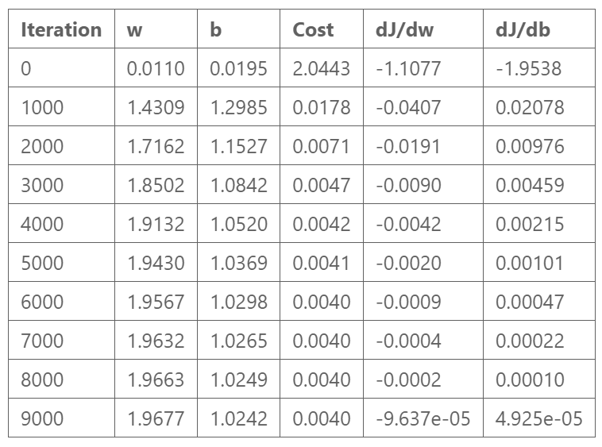
Gradient descent summary

Slide 22
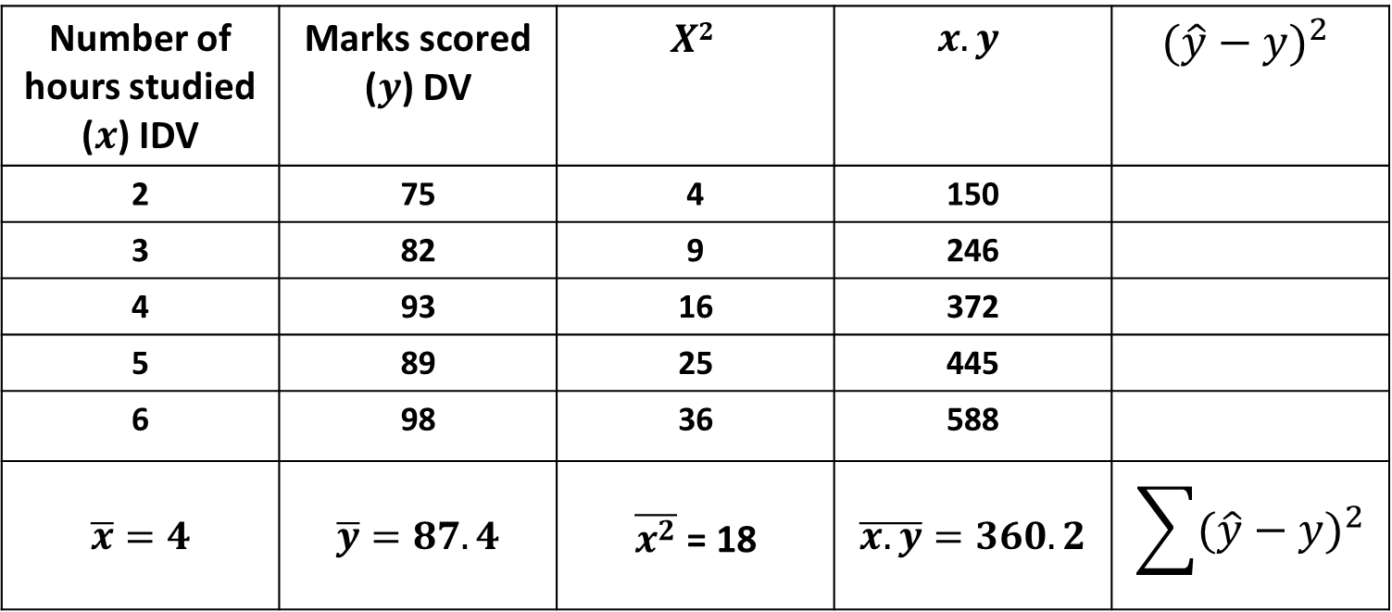
Example-1
Number of hours studied ($x$) IDV | Marks scored ($y$) DV | $$X2$$ | $$x.y$$ | $${(\hat{y}−y)}^{2}$$
2 | 75 | 4 | 150
3 | 82 | 9 | 246
4 | 93 | 16 | 372
5 | 89 | 25 | 445
6 | 98 | 36 | 588
$$\overline{x}=4$$ | $$\overline{y}=87.4$$ | $\overline{x^{2}}$ = 18 | $$\overline{x.y}=360.2$$ | $$\sum{{(\hat{y}−y)}^{2}}$$

Slide 23

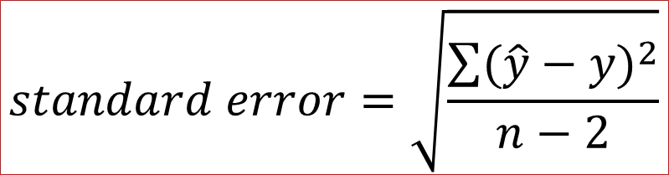
Example-1
$$standard error=\sqrt{\frac{\sum{{(\hat{y}−y)}^{2}}}{n−2}}$$
$standard error=$ 4.012

Slide 24
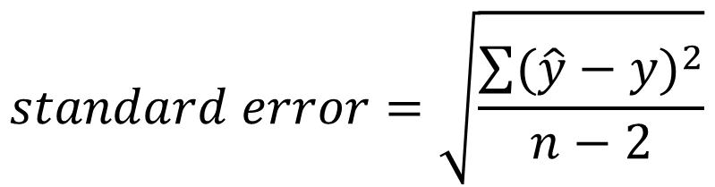
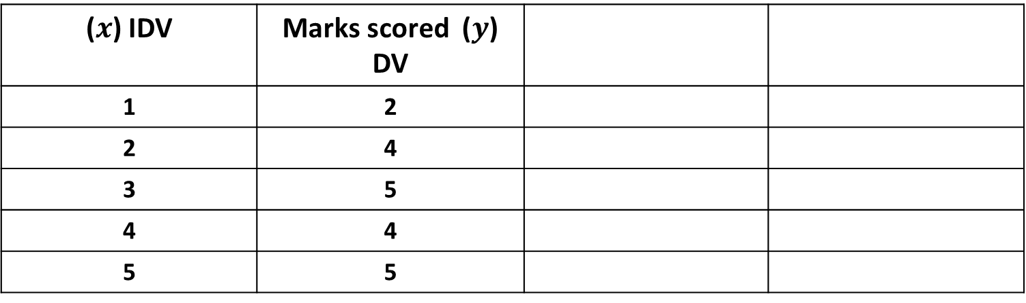
Assignment: Obtain a line that best fit the sample data given in the table. Evaluate the model by finding the standard error.
($x$) IDV | Marks scored ($y$) DV
1 | 2
2 | 4
3 | 5
4 | 4
5 | 5
$$standard error=\sqrt{\frac{\sum{{(\hat{y}−y)}^{2}}}{n−2}}$$

Slide 25
Duration: 60 min
Srikanth Shenoy
AML 5102
M.E. AI & ML
Multiple Linear Regression

Slide 26
Multiple linear regression (MLR)
It is a statistical technique used to predict the relationship between one dependent variable and two or more independent variables
Forecasting - Economics, finance
In biology - patterns detection
To understand the impact of multiple elements on a singular result.

Slide 27


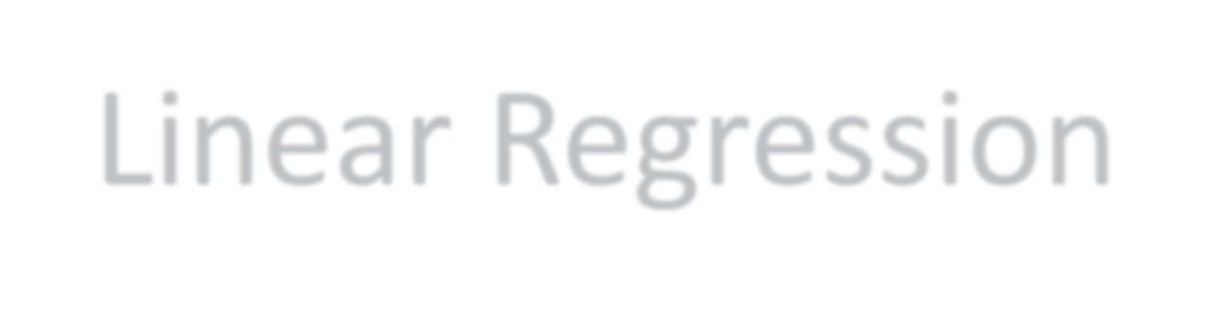
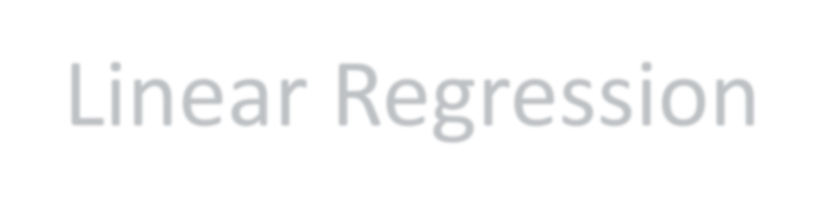
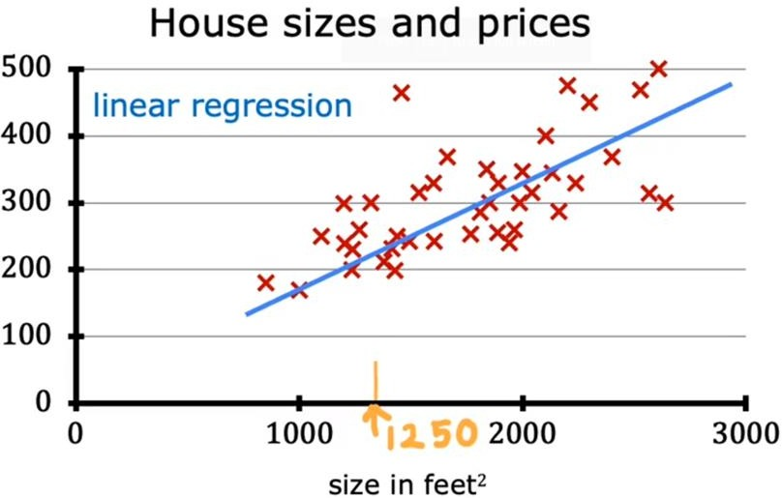
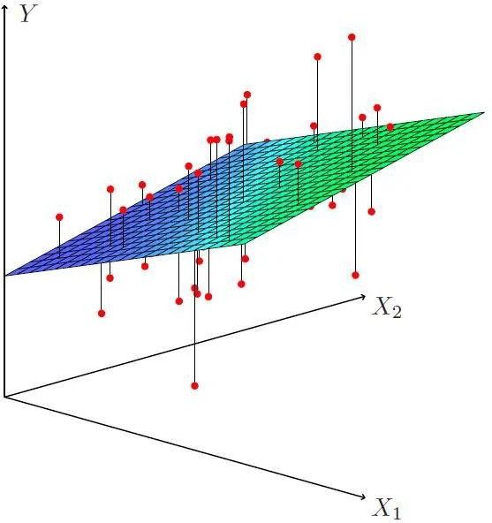
Simple Linear Regression
Multiple Linear Regression
3

Slide 28

General Formula
The equation for multiple linear regression is:
$$\hat{y}= b_{0}+b_{1}∗X_{1}+b_{2}∗X_{2}+…+b_{n}∗X_{n}+ε$$
$$b_{0} −y intercept$$
$$b_{1},b_{2},b_{3} −coefficients$$
$X_{n}$ - IDV
$$\hat{y} −Predicted DV$$
y – DV
$ε$ – error term

Slide 29
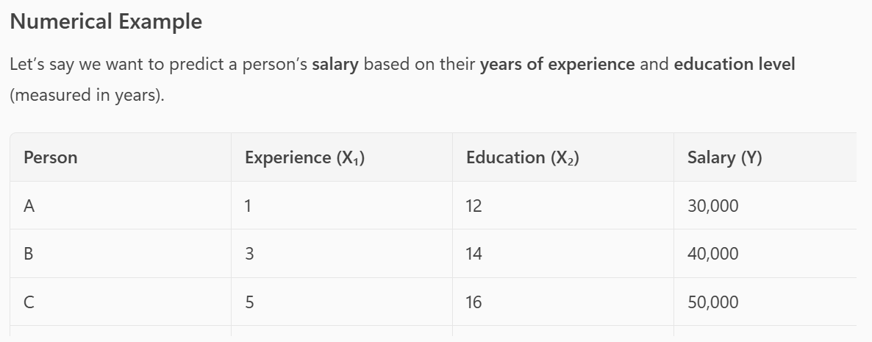
Example
We want to predict the salary of the person based on the years of experience and education level.

Slide 30
Assignment
Explain with example about batch, mini batch & stochastic gradient descent.
Compare batch, mini batch & stochastic gradient descent.
Different evaluation metrics for regression

Slide 31

Thank you

